Slide 1

Application Of Machine Learning Model on Diabetes Data
Miloni Agrawal
PRN: 22060621017
Under the guidance of Prof. Dr. Harsh Tripathi

Slide 2
Introduction
Diabetes is a growing global health concern.
Early prediction can prevent serious complications.
Machine Learning offers potential to detect patterns in clinical data.
This project analyzes a diabetes dataset using ML model to classify individuals as diabetic or non-diabetic.

Slide 3
Objective
Main Goal: Develop a predictive model for diabetes diagnosis using clinical and physiological features.
Specific Objectives:
Preprocess the dataset (scaling, encoding).
• Perform exploratory data analysis (EDA).
• Train & evaluate model: Logistic Regression
• Evaluate the model using key metrics (Accuracy, ROC AUC, etc.).

Slide 4
Methodology- Dataset overview
Age (years), Blood Glucose Level (BGL, mg/dL), Diastolic Blood Pressure (mmHg), Systolic Blood Pressure (mmHg), Heart Rate (beats per minute), Body Temperature (°F), SpO2 (oxygen saturation, %), Sweating (Y/N, binary), Shivering (Y/N, binary), Diabetic/ non-diabetic (binary, target variable)
Target variable: Diabetic/ non-diabetic (binary, target variable)
Tools: Python, Google Colab
Libraries: pandas, seaborn, matplotlib, scikit-learn

Slide 5
Methodology – Preprocessing
Dropped the first row and set the second row as column headers.
Converted the target variable (‘Diabetic/Non-diabetic’) to numeric codes (0 for non-diabetic, 1 for diabetic).
Scaled numerical features using StandardScaler to ensure consistent ranges for model training.

Slide 6
Methodology – EDA
Histograms: Generated for numerical features (Age, BGL, Diastolic BP, Systolic BP, Heart Rate, Body Temperature, SpO2) to visualize their distributions.
Boxplots: Created to identify outliers and assess the spread of numerical features.
Correlation Matrix: Computed to examine relationships between numerical features, visualized using a heatmap.

Slide 7
Methodology – Model Building
The dataset was then split into training (80%) and testing (20%) sets, resulting in 13,575 training samples and 3,394 testing samples after which these classification model was implemented: Logistic Regression
The model was trained on the scaled training data and evaluated on the test set using:
Classification report (precision, recall, F1-score, support).
Confusion matrix

Slide 8
Methodology - Tools and libraries
The analysis was performed in Python using Google Colab, using the following libraries:
• pandas: Data manipulation and analysis.
• matplotlib and seaborn: Data visualization.
• scikit-learn: Machine learning models and evaluation metrics.

Slide 9
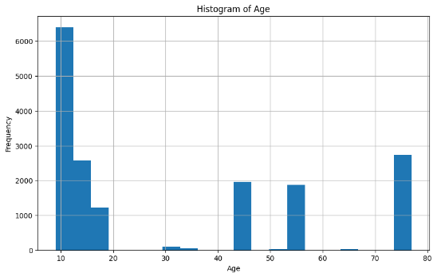
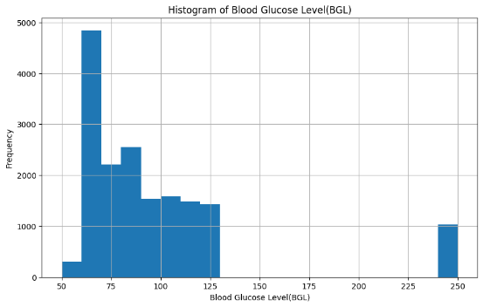
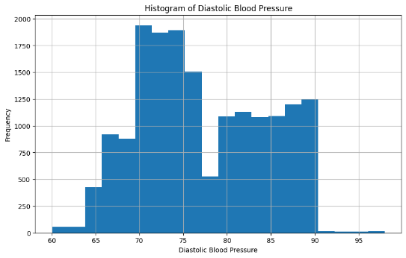
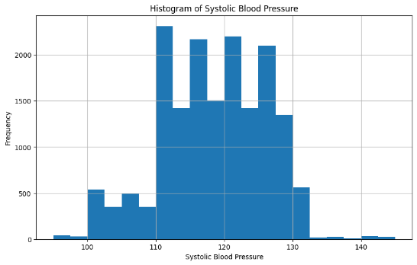
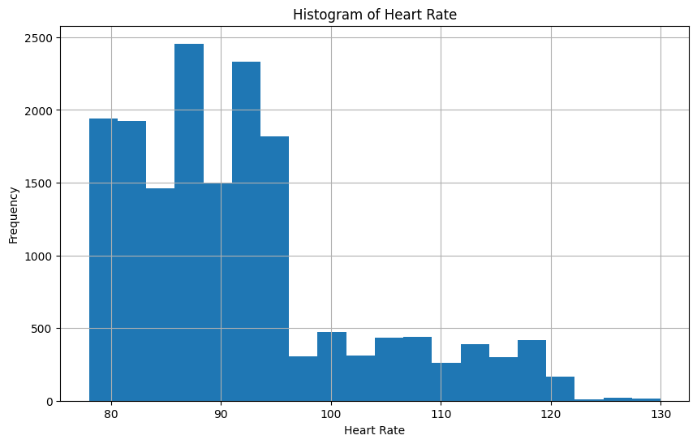
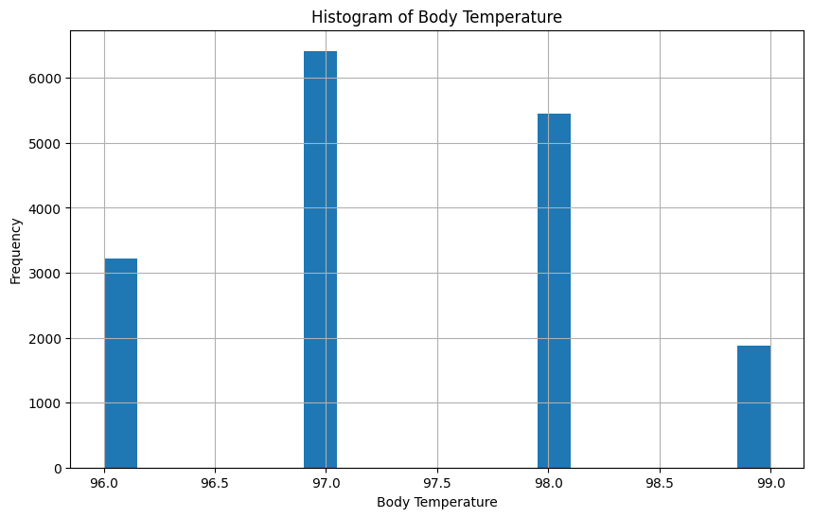
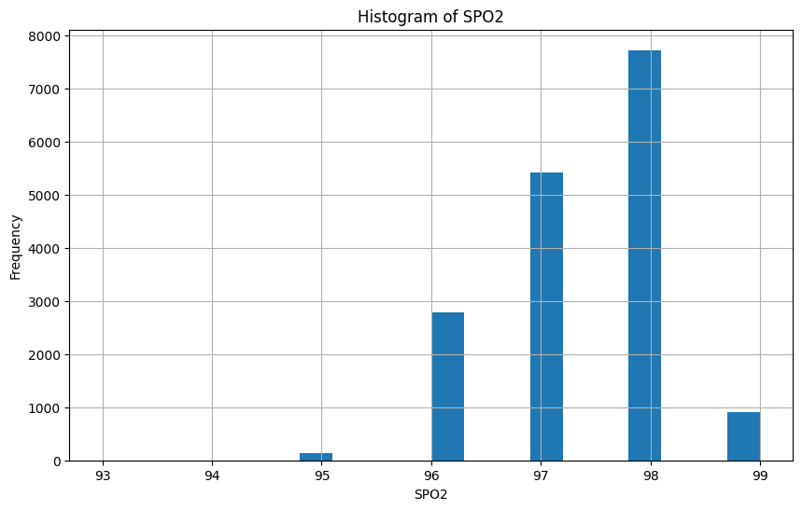
Results - Histograms

Slide 10
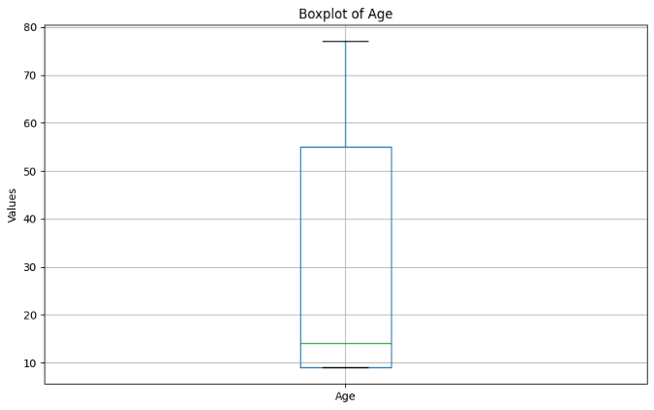
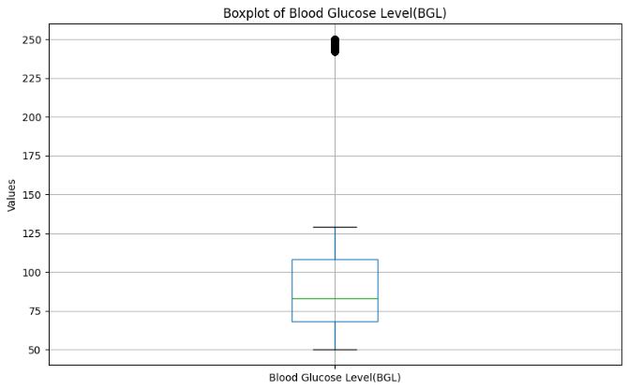
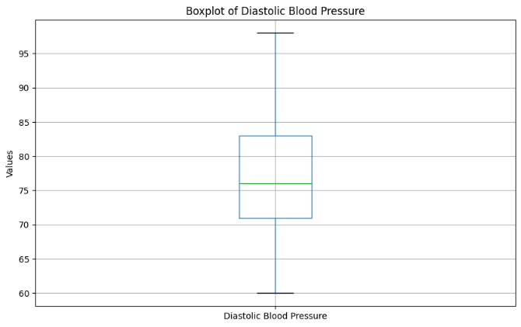
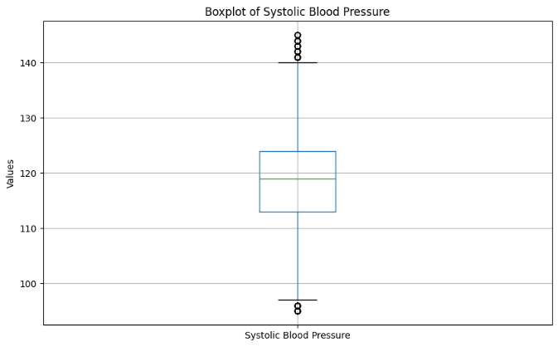
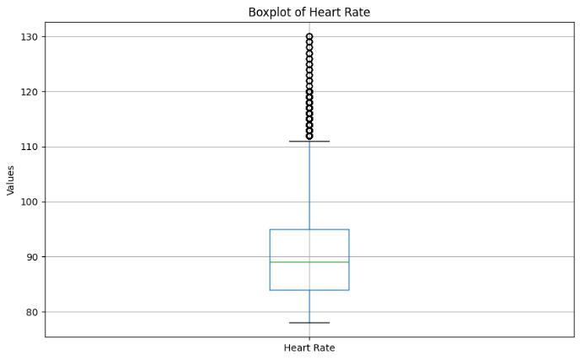
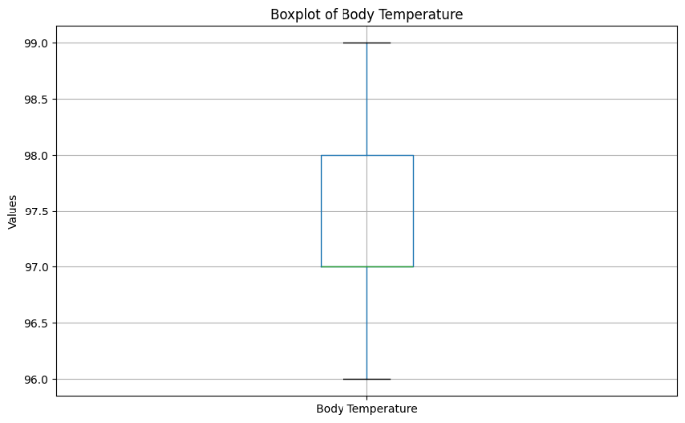
Results - Boxplots

Slide 11
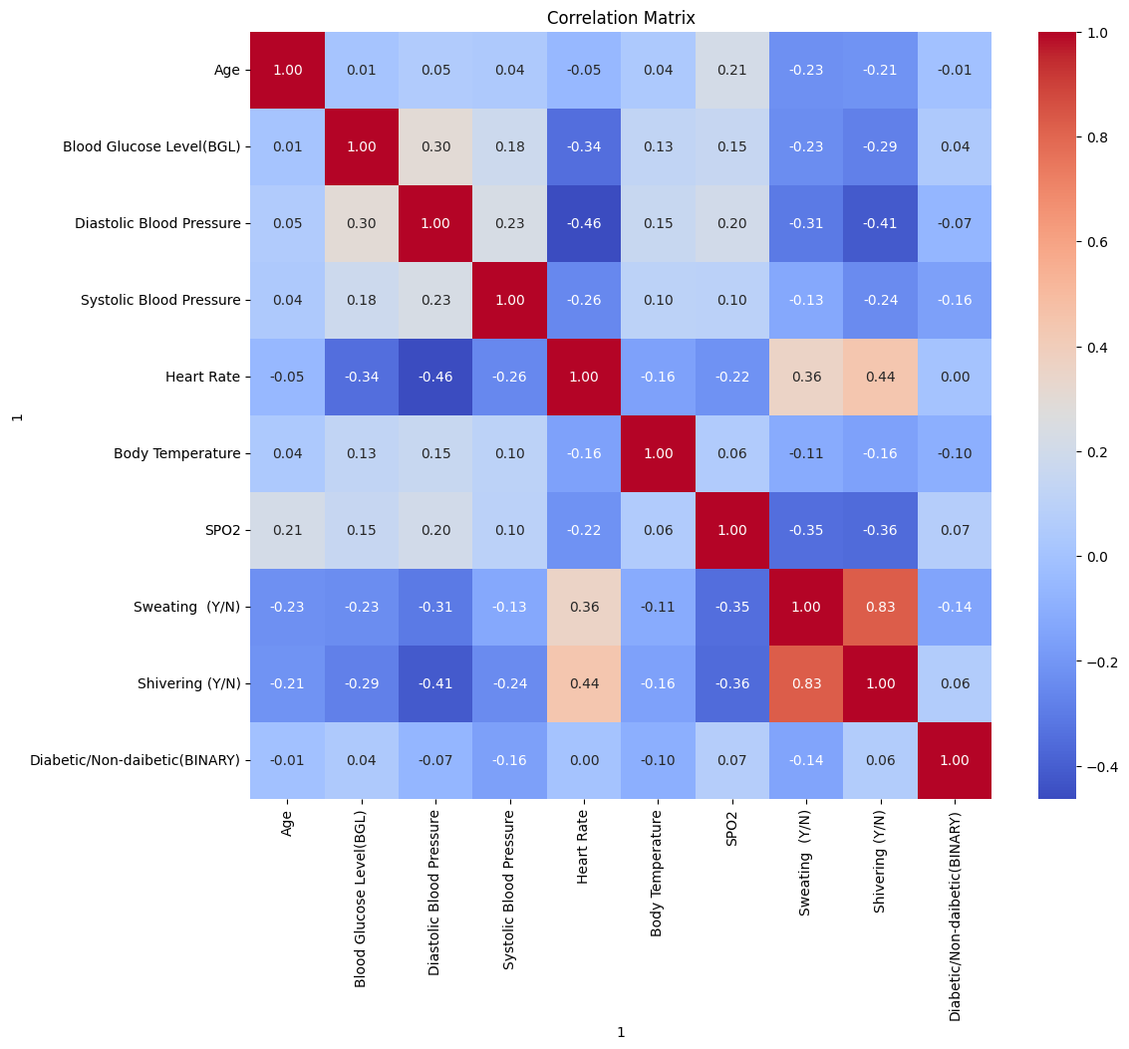
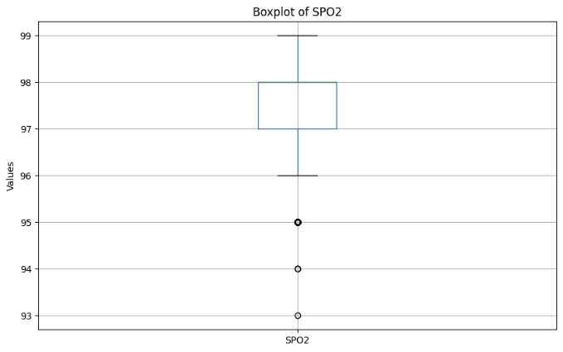
Results

Slide 12
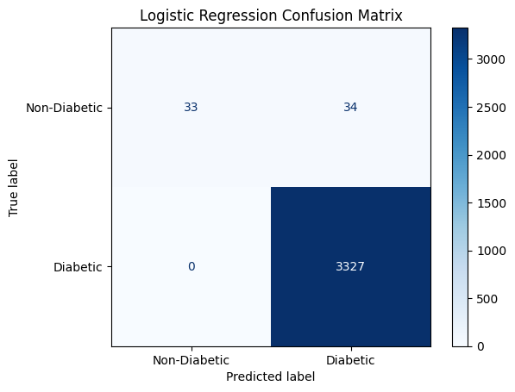
Results – Model performance
 | Logistic Regression
Accuracy | 0.99
Precision | 1.00 (non-diabetic), 0.99 (diabetic)
Recall | 0.49 (non-diabetic), 1.00 (diabetic)
F1-score | 0.66 (non-diabetic), 0.99 (diabetic)
ROC AUC | 0.91

Slide 13
Conclusion
Machine Learning models are effective for diabetes prediction.
Class imbalance significantly affects recall and accuracy
EDA and preprocessing are crucial steps
Future improvements can involve feature engineering, external validation, and deployment for clinical use.

Slide 14
Thank You

